Slide 1
Image deblurring
Huei-Lun Siao

Slide 2
Outline
Image deblurring 介紹
(Zaharescu, M. and Boiangiu C.-A. (2013).
Image deblurring: Challenges and solutions. )
2. 對已知形狀之物體去除移動模糊 (2009)

Slide 3
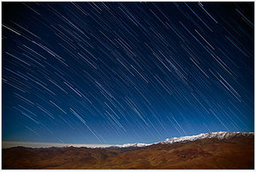
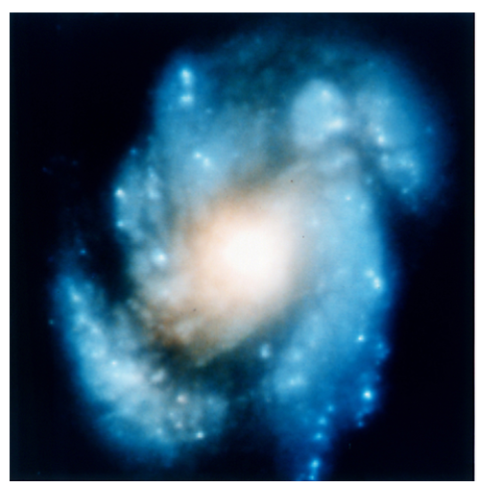
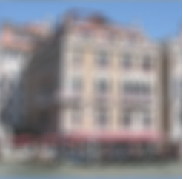
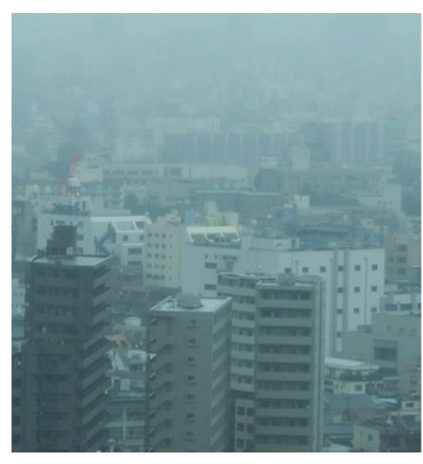
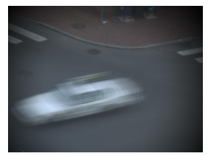
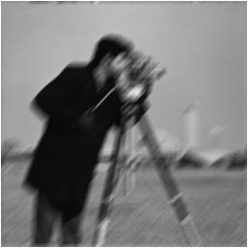

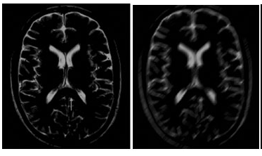
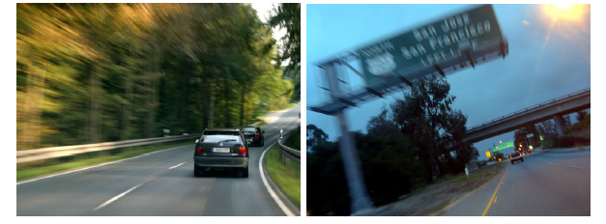
Image Deblurring
Notes:
簡單來說將模糊的照片變清晰

Slide 4



Deconvolution
=
$$⊗$$
實際影像
PSF (point spread function)
理想影像

Slide 5
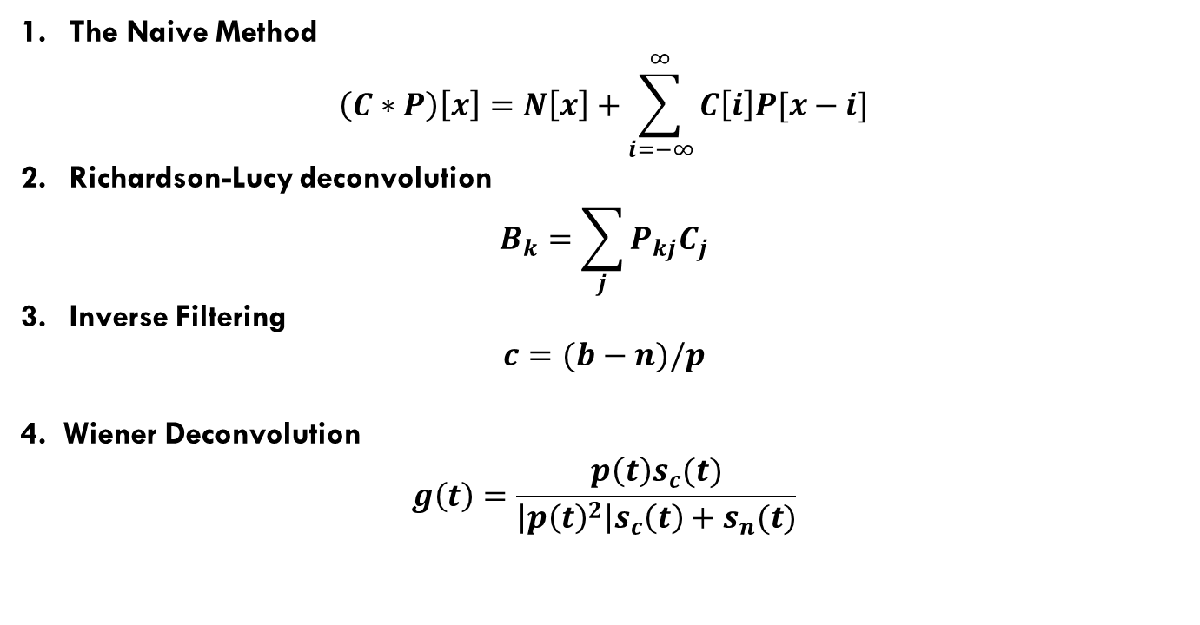
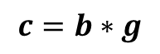
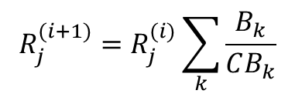
Deblurring Method
$$b\left(t\right) = c\left(t\right) ∗ p\left(t\right) + n(t)$$
Blurred image
Clear image
PSF
noise
The Naive Method
$$\left(C∗P\right)\left[x\right]=N\left[x\right]+\sum_{i=−∞}^{∞}{C\left[i\right]P[x−i]}$$
Richardson-Lucy deconvolution
$$B_{k}=\sum_{j}{P_{kj}C_{j}}$$
Inverse Filtering
$$c=(b−n)/p$$
4. Wiener Deconvolution
$$g\left(t\right)=\frac{p\left(t\right)s_{c}(t)}{\left|p{\left(t\right)}^{2}\right|s_{c}\left(t\right)+s_{n}(t)}$$
$$R_{j}^{(i+1)}=R_{j}^{(i)}\sum_{k}{\frac{B_{k}}{CB_{k}}}$$
Blurred image
correlated image
$$c=b∗g$$

Slide 6
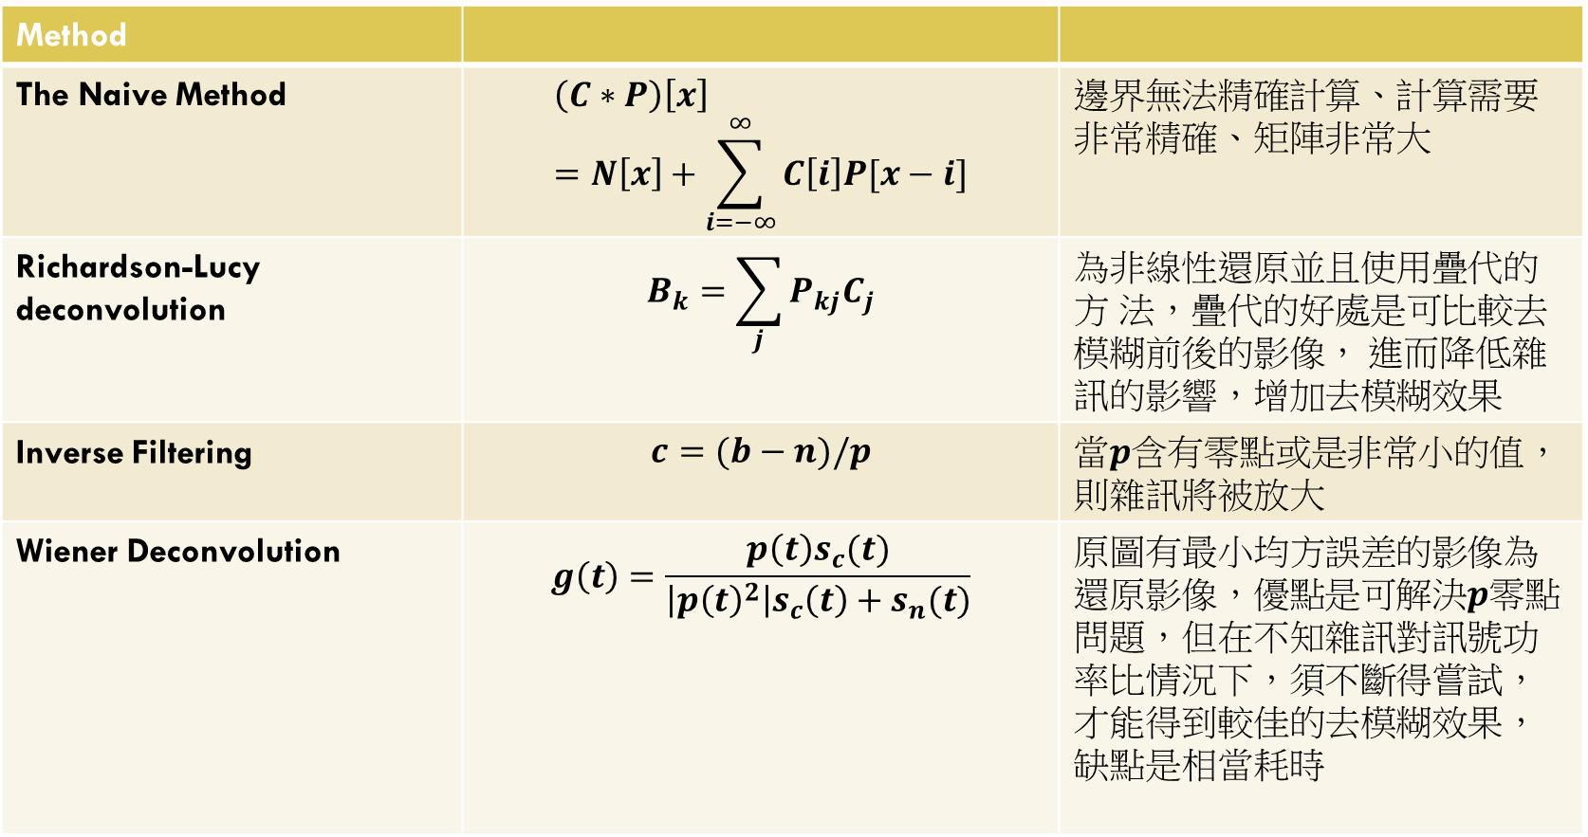
Method
The Naive Method | $$\left(C∗P\right)\left[x\right]=N\left[x\right]+\sum_{i=−∞}^{∞}{C\left[i\right]P[x−i]}$$ | 邊界無法精確計算、計算需要非常精確、矩陣非常大
Richardson-Lucy deconvolution | $$B_{k}=\sum_{j}{P_{kj}C_{j}}$$ | 為非線性還原並且使用疊代的方 法，疊代的好處是可比較去模糊前後的影像， 進而降低雜訊的影響，增加去模糊效果
Inverse Filtering | $$c=(b−n)/p$$ | 當$p$含有零點或是非常小的值，則雜訊將被放大
Wiener Deconvolution | $$g\left(t\right)=\frac{p\left(t\right)s_{c}(t)}{\left|p{\left(t\right)}^{2}\right|s_{c}\left(t\right)+s_{n}(t)}$$ | 原圖有最小均方誤差的影像為還原影像，優點是可解決$p$零點問題，但在不知雜訊對訊號功率比情況下，須不斷得嘗試，才能得到較佳的去模糊效果，缺點是相當耗時

Slide 7
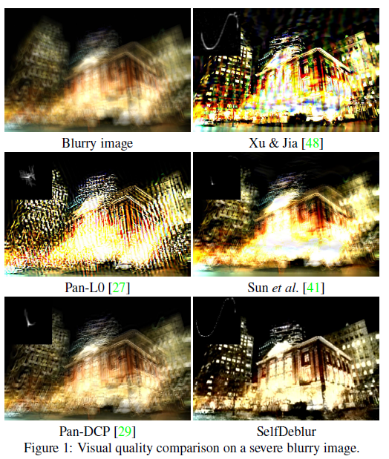
PSF

Slide 8
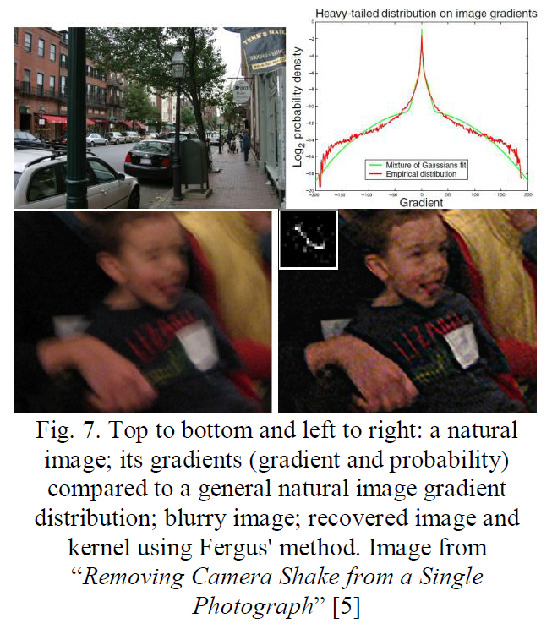
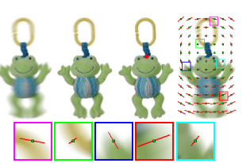
PSF Estimation
Fergus's [5] noticed that all natural clear photographs share a similar histogram of gradients. A blurred image changes the shape of the histogram.
Motion blur

Slide 9
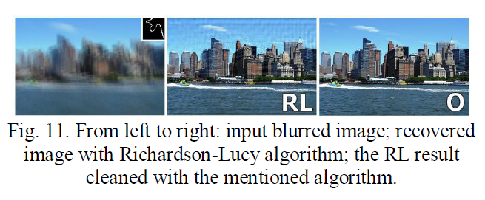
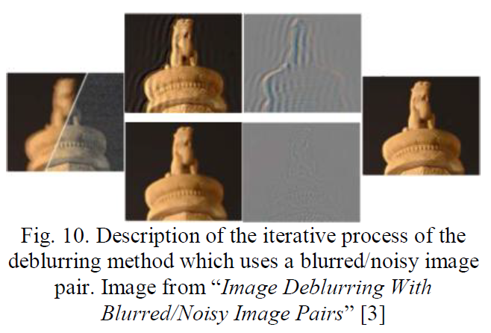
Deringing

Slide 10
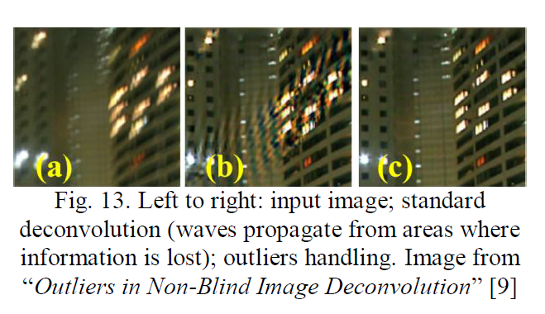
Outliers handling

Slide 11
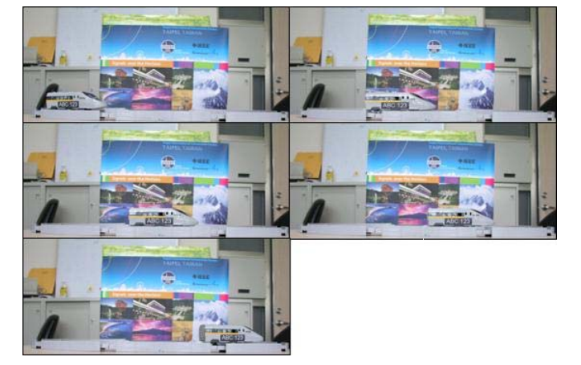
對已知形狀之物體去除移動模糊 (2009)
研究假設
1.相機為靜止不動，只有物體在移動
2.物體的形狀為已知
3. 物體是固定朝著其形狀的某個方向作平移

Slide 12
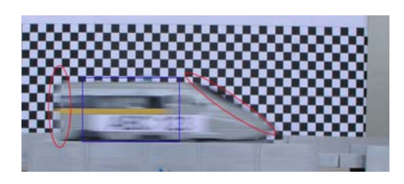
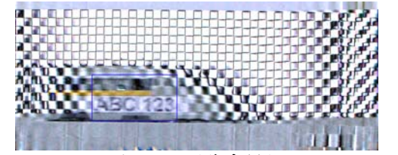
物體因移動發生 的移動模糊可分為兩種
1.物體在相機拍攝期 間(快門打開期間)與相機之間的相對運動造成 物體本身的移動模糊
2. 影像中的背景也隨著 物體的經過，時而遮蔽，時而露出，於是在物 體與背景的邊緣(edge)就會產生一個交疊的現 象，導致物體的邊緣混入了背景成份
全影像去模糊

Slide 13
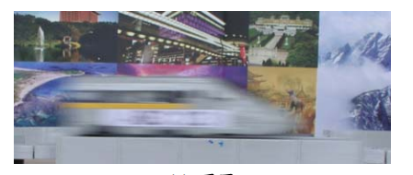
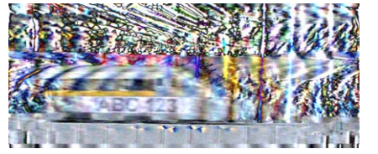
全影像去模糊

Slide 14
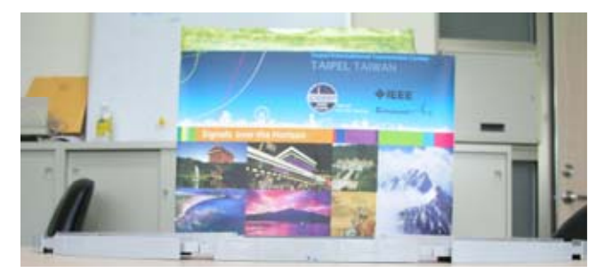
取出純背景圖
每張影像上相同位置的 RGB 三個分量之強度值分別進行排序
取出中間值

Slide 15
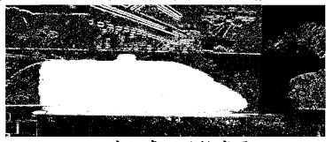
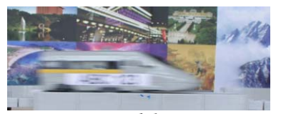

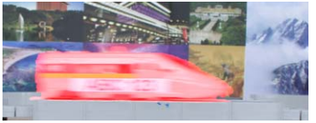
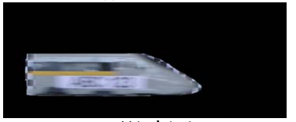
找出模糊的車子
開合、閉合、blob-coloring 找出最大區域
找差值

Slide 16



還原影像
無模糊的影像
$$g= f ∗ h + η$$
原始影像
PSF
雜訊
$$G= F ⋅ H + N$$
(frequency domain)
$$F\left(u,v\right)=\frac{G\left(u,v\right)−N(u,v)}{H(u,v)}$$
Inverse filtering
Wiener filtering
$$\hat{F}\left(u,v\right)=\left[\frac{1}{H\left(u,v\right)}∙\frac{{\left|H\left(u,v\right)\right|}^{2}}{{\left|H\left(u,v\right)\right|}^{2}+K}\right]G(u,v)$$

Slide 17
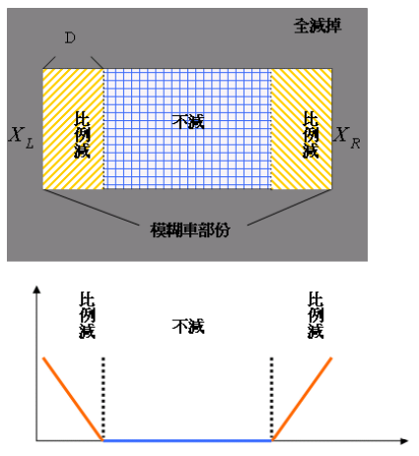
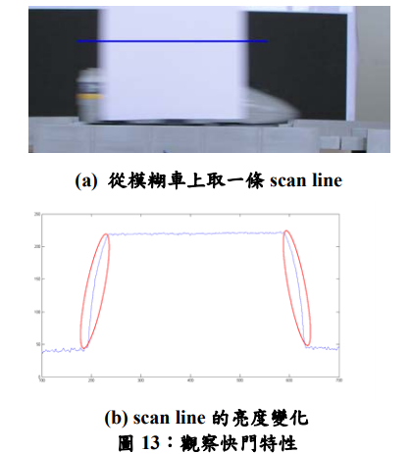
PSF
混入背景模糊部分

Slide 18
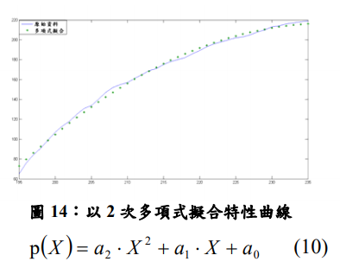
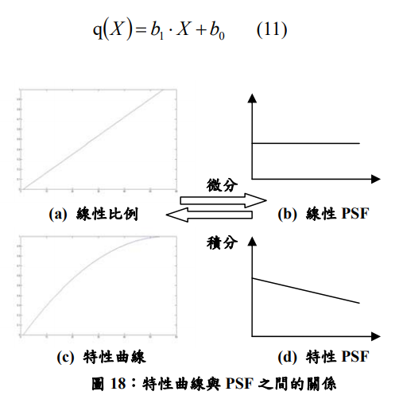

Slide 19
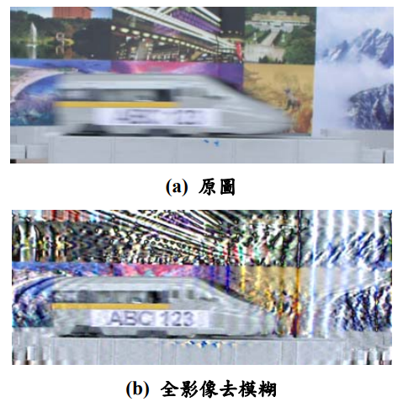
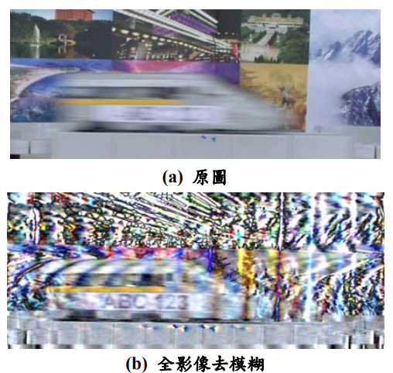
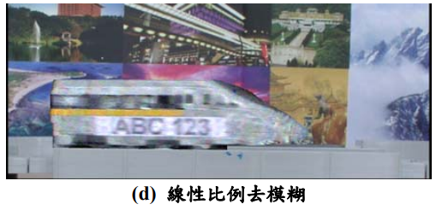
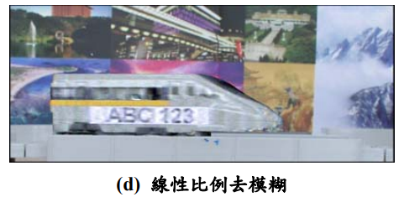
結論
真實影像去模糊結果(1/30 sec)
真實影像去模糊結果(1/15 sec)

Slide 20
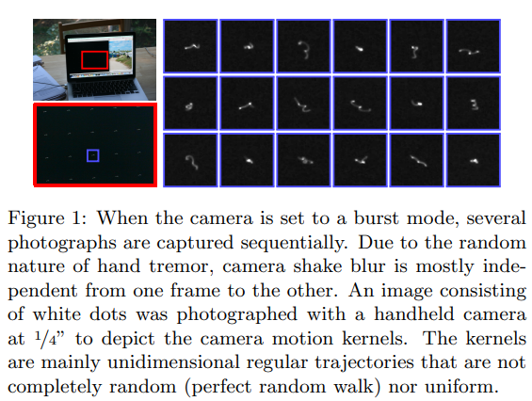
Burst Deblurring: Removing Camera Shake Through Fourier Burst Accumulation
Delbracio, Mauricio, and Guillermo Sapiro(2015)
一張照片的模糊—鏡頭成像帶來的模糊
—手按拍攝鍵帶來的振動

Slide 21
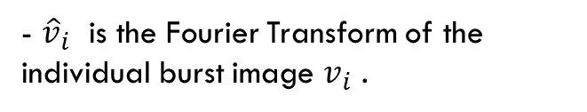
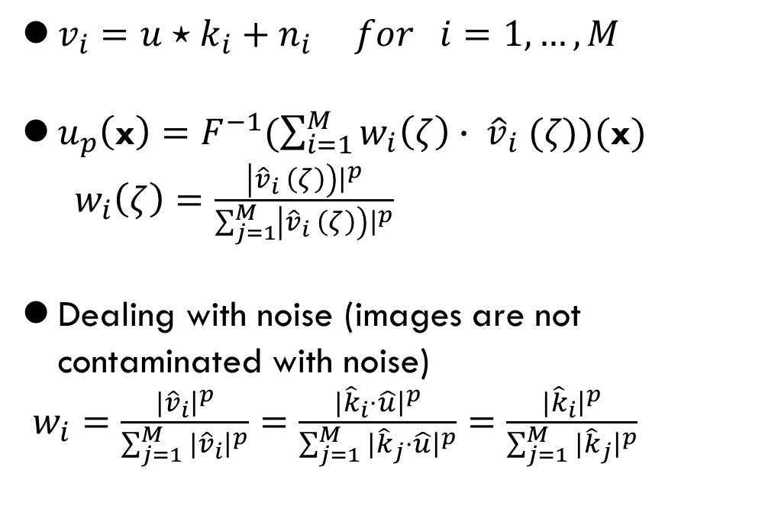
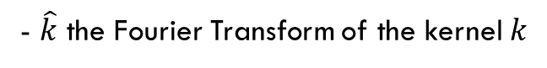


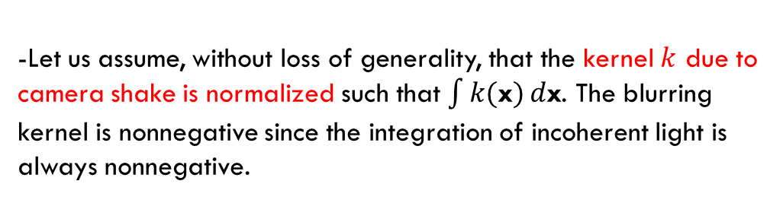

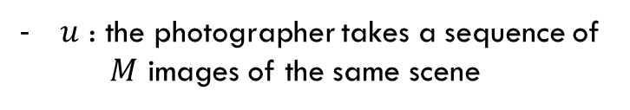
Method
- $F$ denote the Fourier Transform
- $\hat{k}$ the Fourier Transform of the kernel $k$
$v_{i}=u⋆k_{i}+n_{i} for i=1,…,M$
$u_{p}\left(\text{x}\right)=F^{−1}(\sum_{i=1}^{M}{w_{i}\left(ζ\right)}∙ {\hat{v}}_{i} (ζ))(\text{x})$
$w_{i}\left(ζ\right)=\frac{\left|{\hat{v}}_{i} \left(ζ\right)\right){\left.​\right|}^{p}}{\sum_{j=1}^{M}{\left|{\hat{v}}_{i} \left(ζ\right)\right){\left.​\right|}^{p}}}$
Dealing with noise (images are not contaminated with noise)
$w_{i}=\frac{|{\hat{v}}_{i}{\left.​\right|}^{p}}{\sum_{j=1}^{M}{|{\hat{v}}_{i}{\left.​\right|}^{p}}}=\frac{|{\hat{k}}_{i}{⋅\hat{u}\left.​\right|}^{p}}{\sum_{j=1}^{M}{|{\hat{k}}_{j}{⋅\hat{u}\left.​\right|}^{p}}}=$ $\frac{|{\hat{k}}_{i}{\left.​\right|}^{p}}{\sum_{j=1}^{M}{|{\hat{k}}_{j}{\left.​\right|}^{p}}}$
- $\text{x}$ : images in a regular grid indexed
by the 2D position
- $ζ :$the Fourier domain is indexed
by the 2D frequency.
- ${\hat{v}}_{i}$ is the Fourier Transform of the individual burst image $v_{i}$ .
$u$ : the photographer takes a sequence of
$M$ images of the same scene
-Let us assume, without loss of generality, that the kernel $k$ due to camera shake is normalized such that $\int{k(\text{x})}d\text{x}$. The blurring kernel is nonnegative since the integration of incoherent light is always nonnegative.

Slide 22
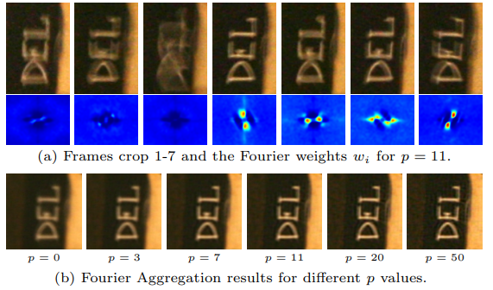

Slide 23
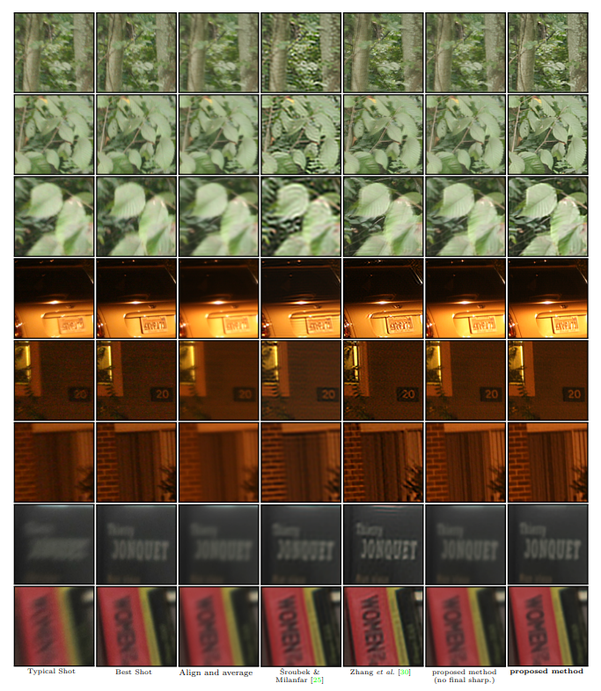

Slide 24
reference
1. Zaharescu, M. and Boiangiu C.-A. (2013). Image deblurring: Challenges and solutions. image 9, 10.
2.
3. https://github.com/subeeshvasu/Awesome-Deblurring

